Slide 1
Text Classification
Group 6

Slide 2
Agenda
Selected Books
Visualization
Preprocessing & Feature Engineering
Modeling
Champoin Model Analysis

Slide 3





Selected Books
Detective and mystery stories category

Slide 4
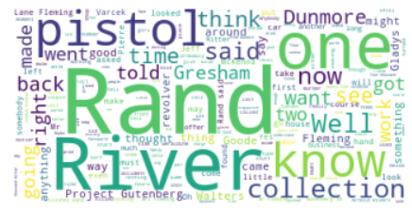

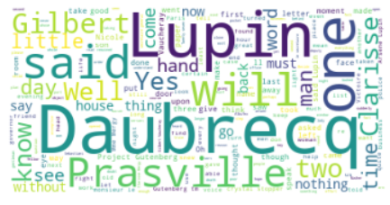
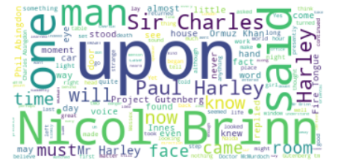
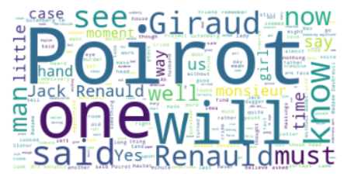
Visualizations
Book 1
Book 2
Book 5
Book 3
Book 4

Slide 5
Preprocessing
Download books.
Tokenize words.
Remove stop words and punctuation marks.
Skip the first 100 words.
Create partitions.
Add to dataframe.
Shuffle dataframe.

Slide 6
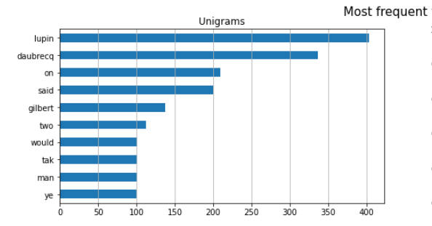
Feature Engineering
BOW
min_df=50
ngram_range=(1,2)
TF/IDF
Stemming
Lemmitization
Uni-grams after stemming for Book 5

Slide 7
Feature Engineering
BOW
min_df=50
ngram_range=(1,2)
TF/IDF
Stemming
Lemmitization

Slide 8
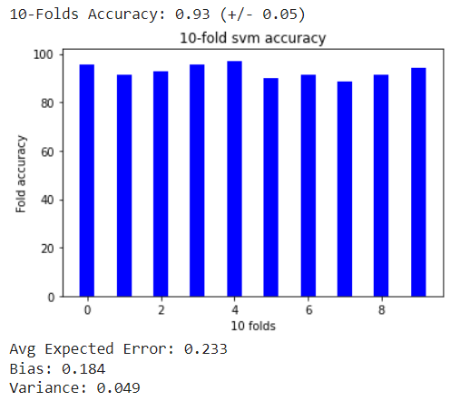
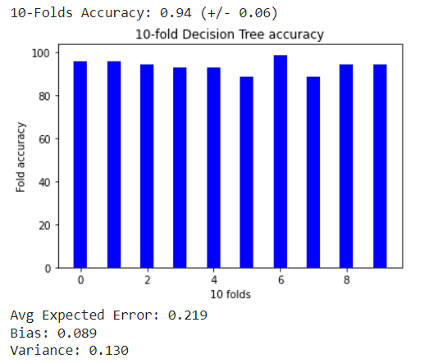
Modeling
SVM
Decision Tree
Selected Features
BOW (min_df=50)
TF/IDF
Selected Features
BOW (min_df=30,ngram_range=(1,2))
TF/IDF
Notes:
Stratified train test split was used to avoid bias in data

Slide 9
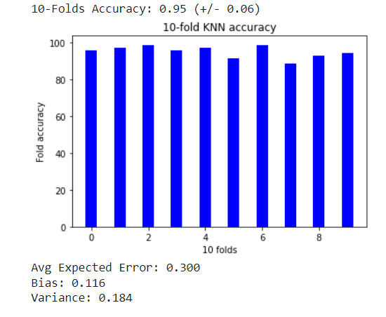
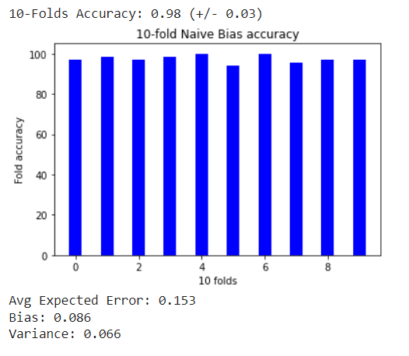
Modeling
KNN
Naïve Bias
Selected Features
BOW (min_df=30,ngram_range=(1,2))
TF/IDF
Selected Features
BOW (min_df=30,ngram_range=(1,2))
TF/IDF

Slide 10
Models Comparison
Model | 10-Folds error | Variance | Bias
SVM | 91% | 0.184 | 0.049
Decision Tree | 94% | 0.130 | 0.089
KNN | 95% | 0.184 | 0.116
Naïve Bias | 98% | 0.066 | 0.086

Slide 11
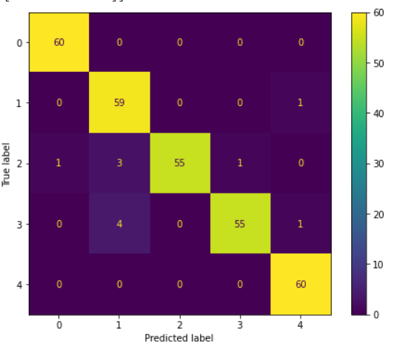

Champion Model Analysis – Naïve Bias
Confusion matrix for test data results
Word cloud for incorrect predictions

Slide 12
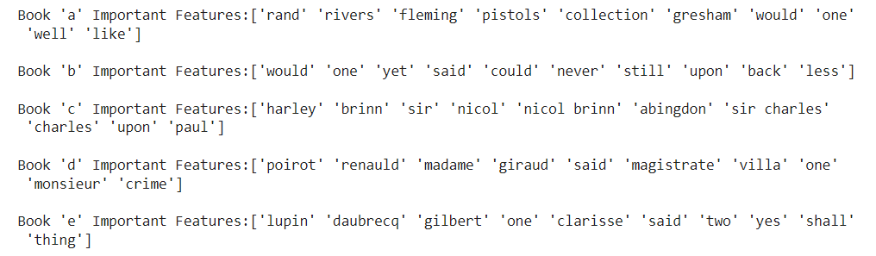
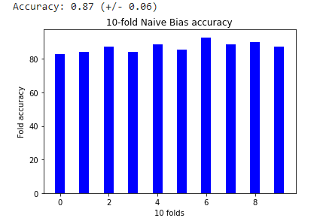
Champion Model Analysis – Naïve Bias
Important features for every book
Results of removing main characters names

Slide 13
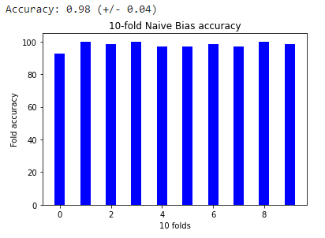
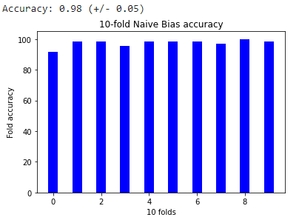
Champion Model Analysis – Naïve Bias
Testing stemming partitions words
Testing lemmatizing partitions words

Slide 14
Thank You

